Slide 1

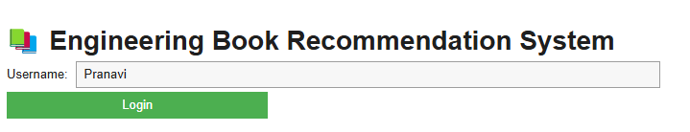
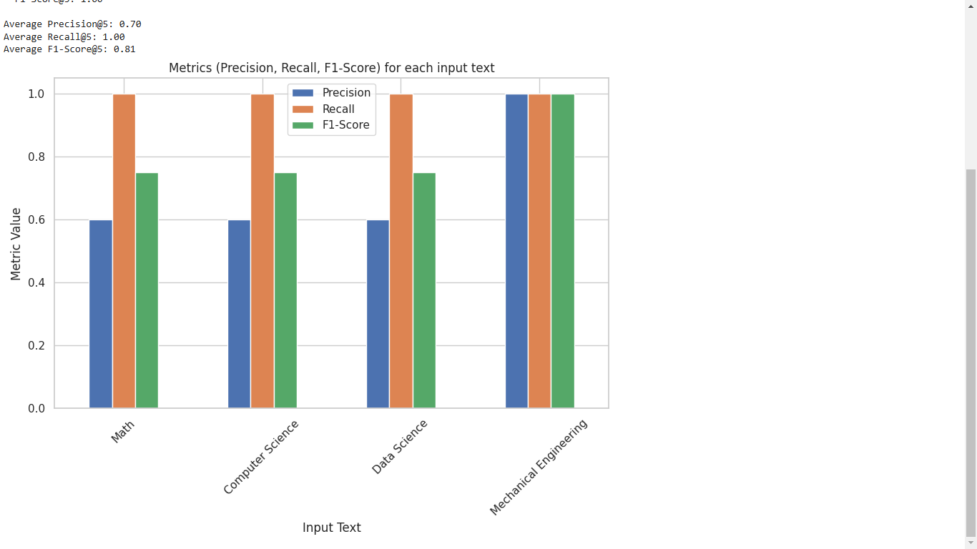
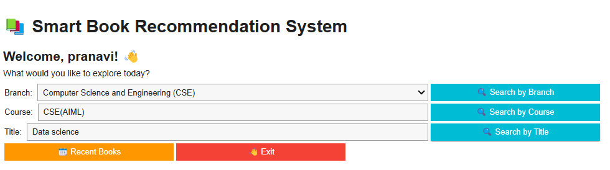

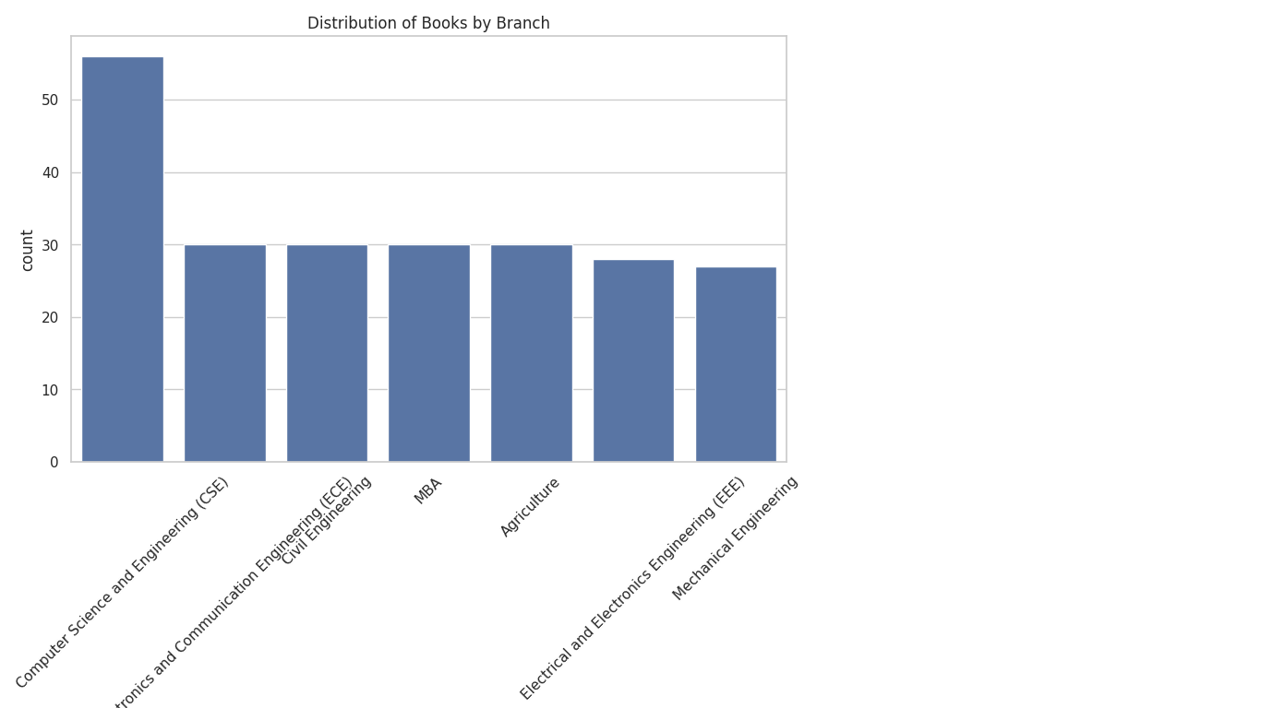
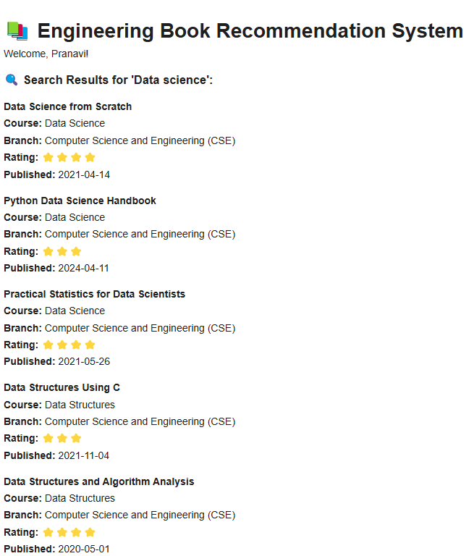

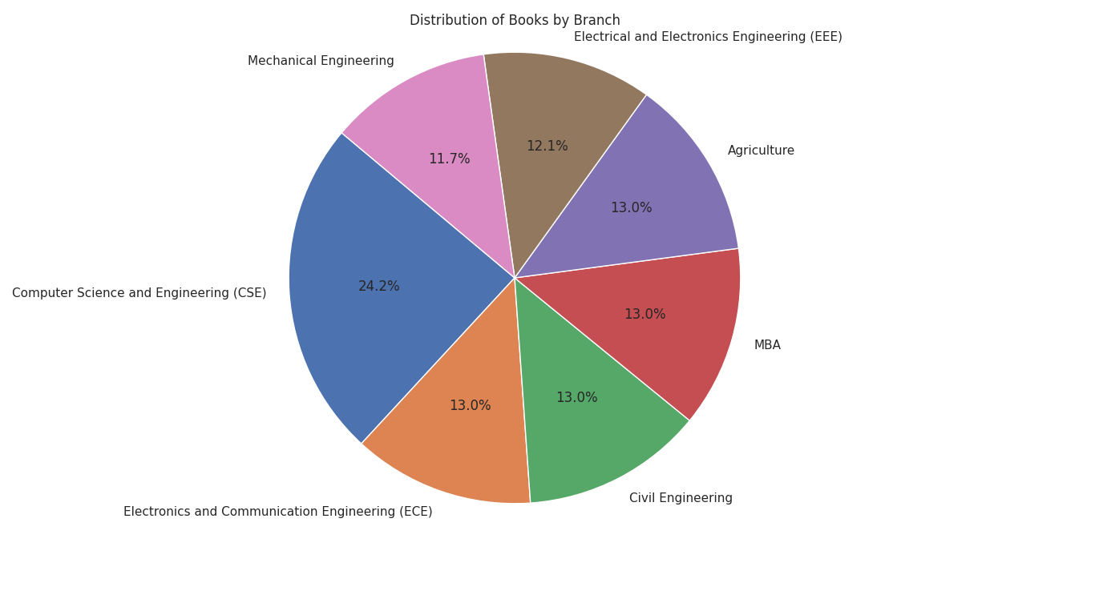
ENHANCING STUDENT ENGAGEMENT IN ENGINEERING COURSES THROUGH PERSONALIZED BOOK RECOMMENDATIONS
CH.ASHWINI (2103A52028)
T.SAIPRIYA (2103A52110)
B.SHASHANKA (2103A52005)
K.MADHUSREE (2103A52090)
M.PRANAVI (2203A52L02)
SR UNIVERSITY
SCHOOL OF COMPUTER SCIENCE & ARTIFICIAL INTELLIGENCE
Abstract
Methodology
Results
Comparison
The System provides tailored reading recommendations for academic purpose. The project, named “Enhanching Student Engagement in Engineering Courses through Personalized Book Recommendations”, covers a wide range of book genres and is intended to benefit students in a number of academic subjects, such as computer science, electronics, artificial intelligence . It makes use of two main approaches: content-based filtering, which proposes books based on a students search history and preferences, and collaborative filtering, which makes book recommendations based on the tastes of students wits by combining various methods. In addition, the system tackles issues like data sparsity and the cold-start problem, which involves making recommendations for new users. Metrics like as recall and precision are used to evaluate the system’s efficacy in making suggestions that correspond with students’ academic level.
.
Data Collection and Preparation - Gather and clean data from the library, ensuring completeness in columns like Book Title, Course, and Rating. Convert text and categorical data into a format suitable for machine learning, such as TF-IDF vectorization.
Content-Based Filtering System - Use TF-IDF or Word2Vec on Description and Course fields to create vector representations. Calculate cosine similarity to recommend books that match user preferences in content, course, or branch.
Collaborative Filtering System - Create a user-item matrix from Ratings to support recommendations based on user behaviors. Use techniques like SVD or KNN to recommend highly rated books from similar users, handling new users with popular branch-specific recommendations.
Book Availability Search - Allow users to search by book title, checking against the dataset for availability. If unavailable, suggest similar books based on content filtering.
Latest Book Recommendations - Sort books by Published Date to recommend the newest additions, displaying recent books prominently to increase student engagement.
Frontend Development and User Interaction - Develop a web application where users can input branch, course, or book title, and view recommendations, availability status, and latest books based on their inputs.
Testing and Evaluation Model Testing: Evaluate each recommendation approach independently using metrics like Mean Absolute Error (MAE) for collaborative filtering and Precision/Recall for content-based recommendations.
Add your information, graphs and images to this section.
Fig: 2.1
Fig:3.1 comparison of 3 metrices
Introduction
Fig: 2.2
The project "Enhancing Student Engagement in Engineering Courses through Personalized Book Recommendations" aims to improve learning experiences for engineering students by leveraging personalized content delivery. In today’s interdisciplinary academic environment, students from diverse fields such as Computer Science, Electronics, and Artificial Intelligence require tailored resources that align with their academic and personal interests. This system addresses that need by offering book recommendations across a wide variety of genres using advanced filtering techniques. Through the combination of collaborative filtering, which leverages the preferences of similar users, and content-based filtering, which matches resources to individual search histories and preferences, the platform delivers highly personalized recommendations. This approach not only enhances academic engagement but also addresses key challenges such as the cold-start problem for new users and data sparsity. By focusing on precision and relevance, the system aims to significantly contribute to student success and engagement across multiple disciplines.
Conclusion
From above results we conclude that In this work, The recommendation system achieves high recall, ensuring relevant book coverage across all fields, with an average F1-Score of 0.81. However, improving precision in subjects like Math, Computer Science, and Data Science could enhance recommendation accuracy.
Acknowledgements
Fig 1.1 Bar Plot
hj
We would like to express our sincere gratitude to Dr. Sheshikala Martha madam Head- Computer Science And Engineering
Ms Faiza Iram Madam for their valuable guidance and wavering support throughout the completion of this project. Their expertise, insightful feedback, and encouragement have been instrumental in shaping the direction of our work and overcoming challenges along the way.
We are deeply thankful for Ms Faiza Iram Madam mentorship and leadership, which have undoubtedly contributed to the successful completion of this project. Her wisdom and guidance will continue to inspire us in our future endeavors.
Fig 1.2 Pie Chart
Fig: 2.3

